Slide 1
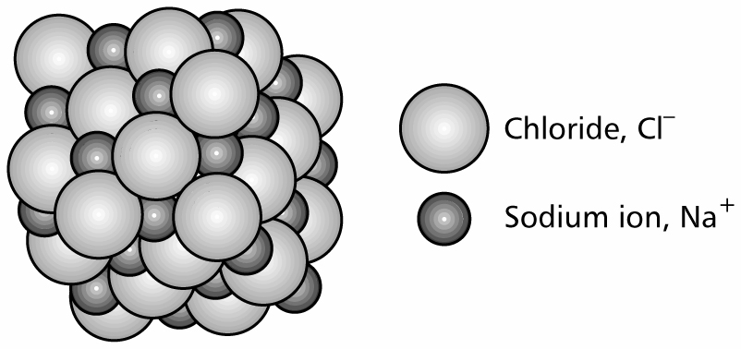
OCR CHEMISTRY MODULE 1
Ionic Bonding

Slide 2
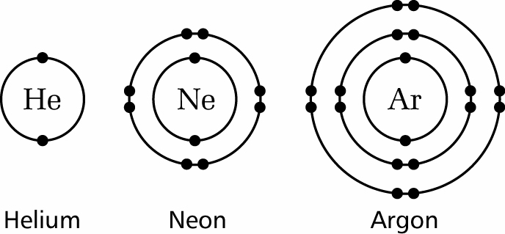
Noble gases are chemically stable because they have full outer shells of electrons

Slide 3
s-block elements lose one or more electrons to form stable cations (positively charged ions).
Group 1 sodium
Na → Na⁺ + e⁻
(2,8,1) (2,8)
Group 2 magnesium
Mg → Mg²⁺ + 2e⁻
(2,8,2) (2,8)

Slide 4
p-block elements gain one or more electrons to form stable anions (negatively charged ions).
Group 6 oxygen
O + 2e⁻ → O²⁻
(2,6) (2,8)
Group 7 chlorine
Cl + e⁻ → Cl⁻
(2,7) (2,8)
There is a transfer of electrons from metal atoms to non- metal atoms to form anions and cations with stable electronic configurations.

Slide 5
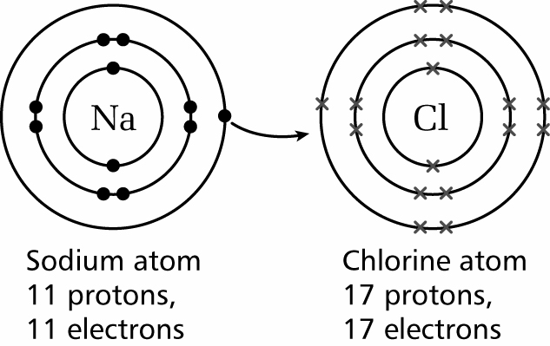
There is a transfer of electrons from metal atoms to non- metal atoms to form anions and cations with stable electronic configurations.

Slide 6
‘Dot-and-cross’ diagram for the formation of sodium chloride

Slide 7
An ionic bond is the electrostatic force of attraction between oppositely charged ions.
Millions of anions and cations pack together in a giant ionic lattice.

Slide 8
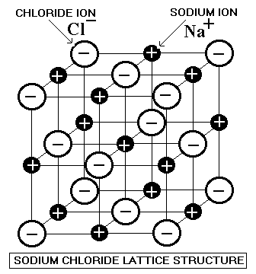

Slide 9
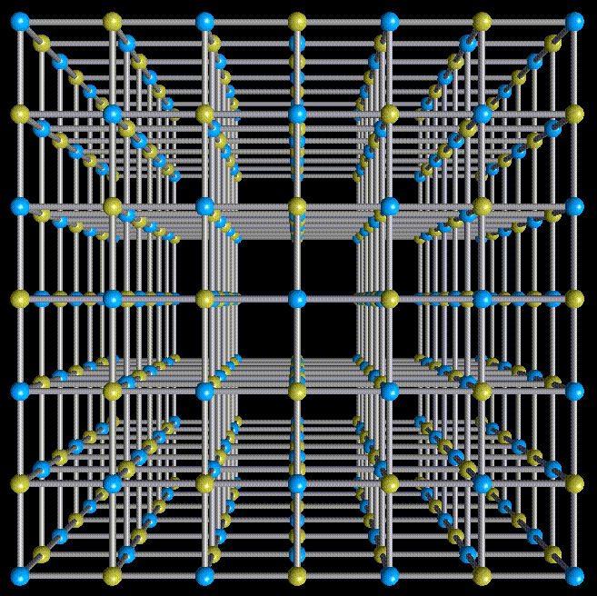

Slide 10
Properties of ionic compounds
Usually have high melting points
Are often soluble in water
Always conduct electricity when melted or dissolved in water

Slide 11
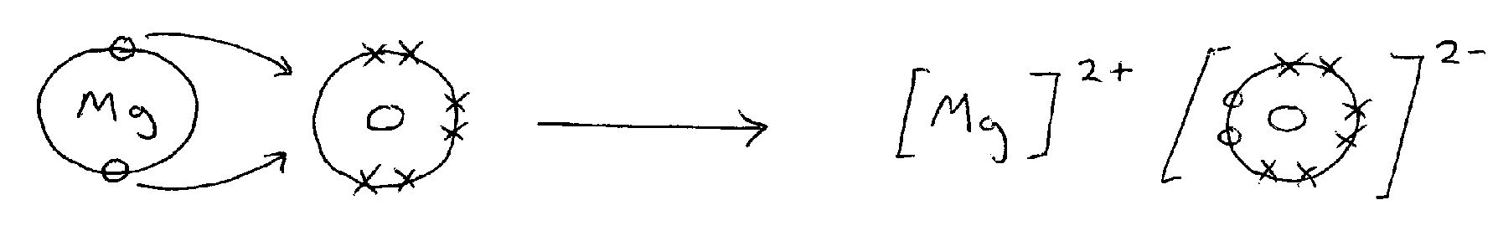
Draw a ‘dot-and-cross’ diagram for the formation of magnesium oxide

Slide 12
Q Why do ionic compounds have high melting points?
A Energy must be supplied to break the strong electrostatic forces (ionic bonds) between the anions and cations in the giant lattice.
Q Why does magnesium oxide have a higher melting point than sodium chloride?
A There are stronger electrostatic forces between the ions because they have double the charge.

Slide 13
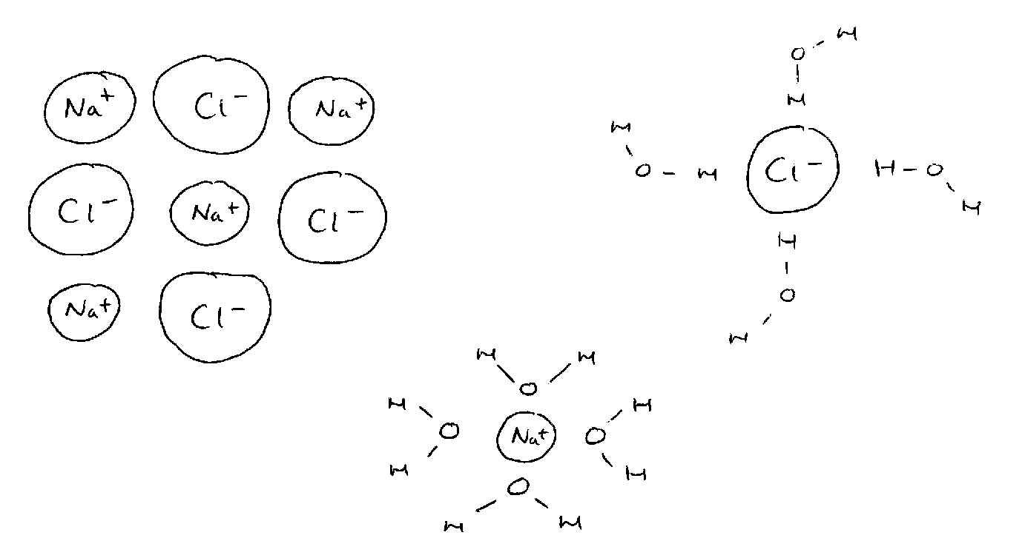
Q What happens when an ionic compound dissolves in water?
A The ions are attracted to water molecules and separate from the lattice. The anions and cations are hydrated; surrounded by water molecules in aqueous solution.

Slide 14
Q Why are some ionic compounds insoluble in water?
A The is insufficient attraction to water molecules to overcome the strong electrostatic forces of attraction in the crystal lattice.

Slide 15
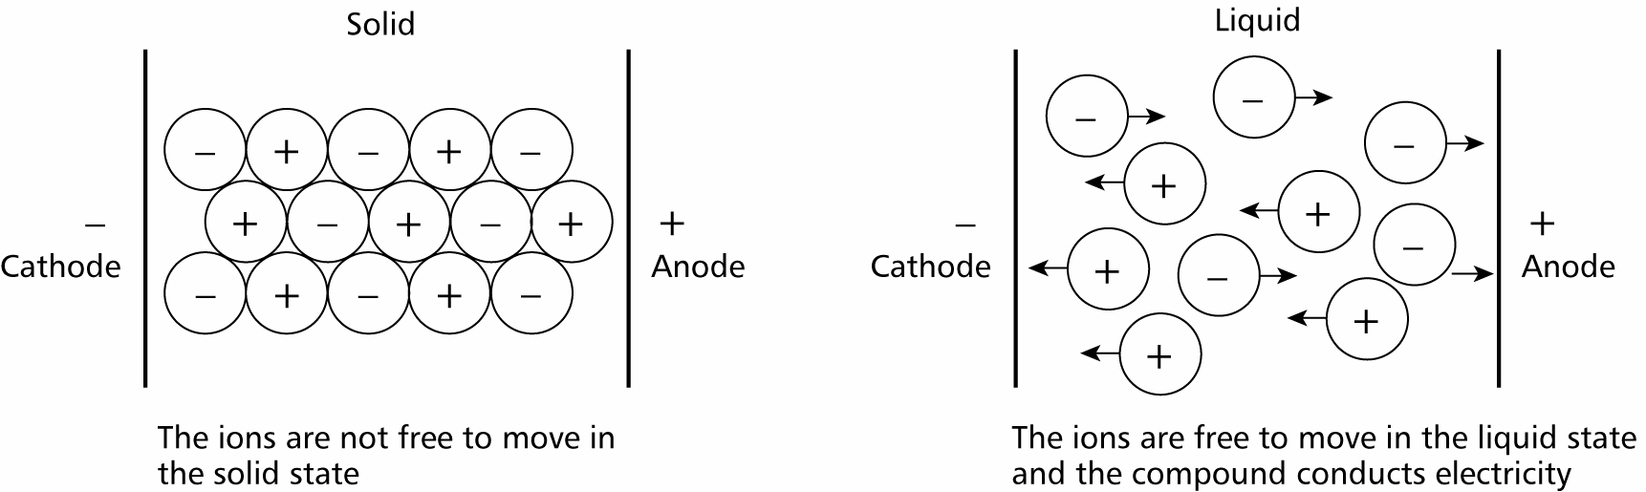
Ionic compounds only conduct electricity when melted or dissolved in water?

Slide 16
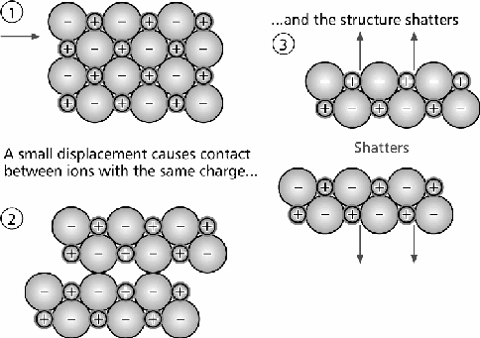
Ionic compounds strong but brittle?

Slide 17
SOLUBILITY RULES
Nitrates are soluble
Sulphates are soluble except lead and barium sulphate
Chlorides are soluble except silver and lead chloride
Bromides bromide
Iodides iodide
Carbonates are insoluble except sodium and potassium carbonate

